Slide 1
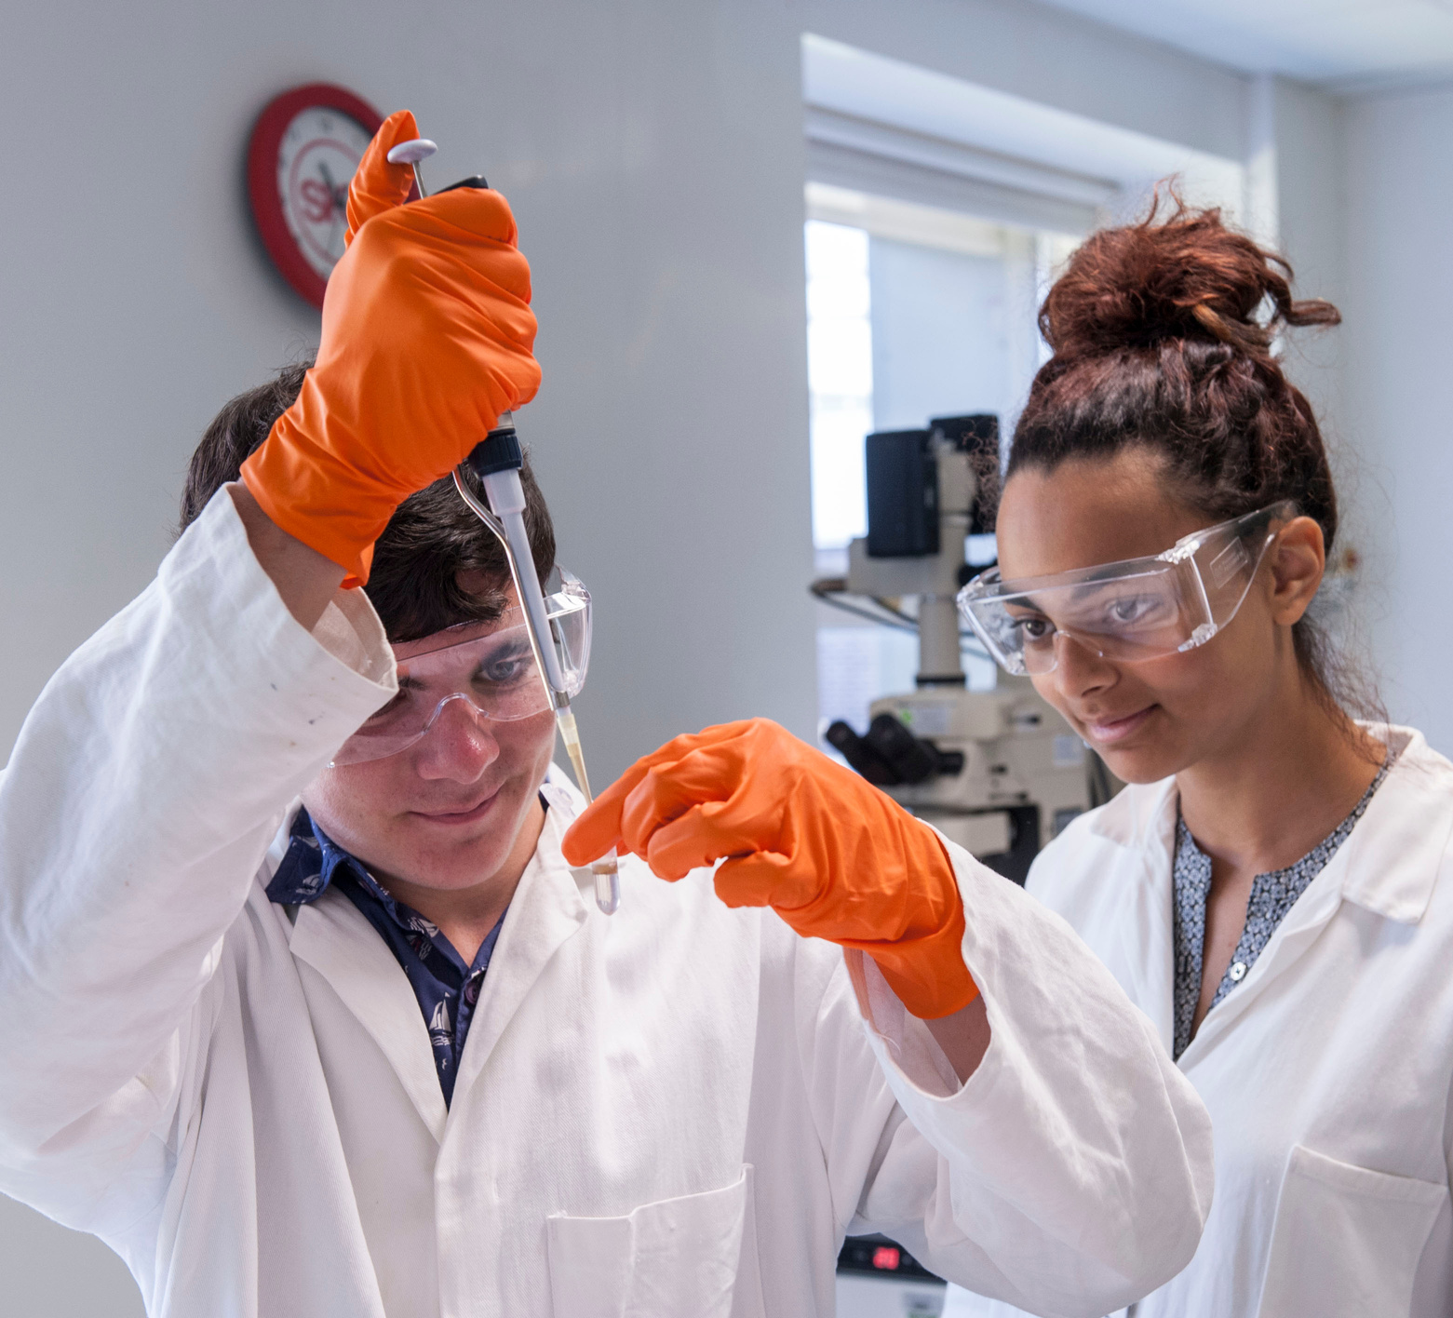

Welcome
to the Youth STEMM Award!

Slide 2
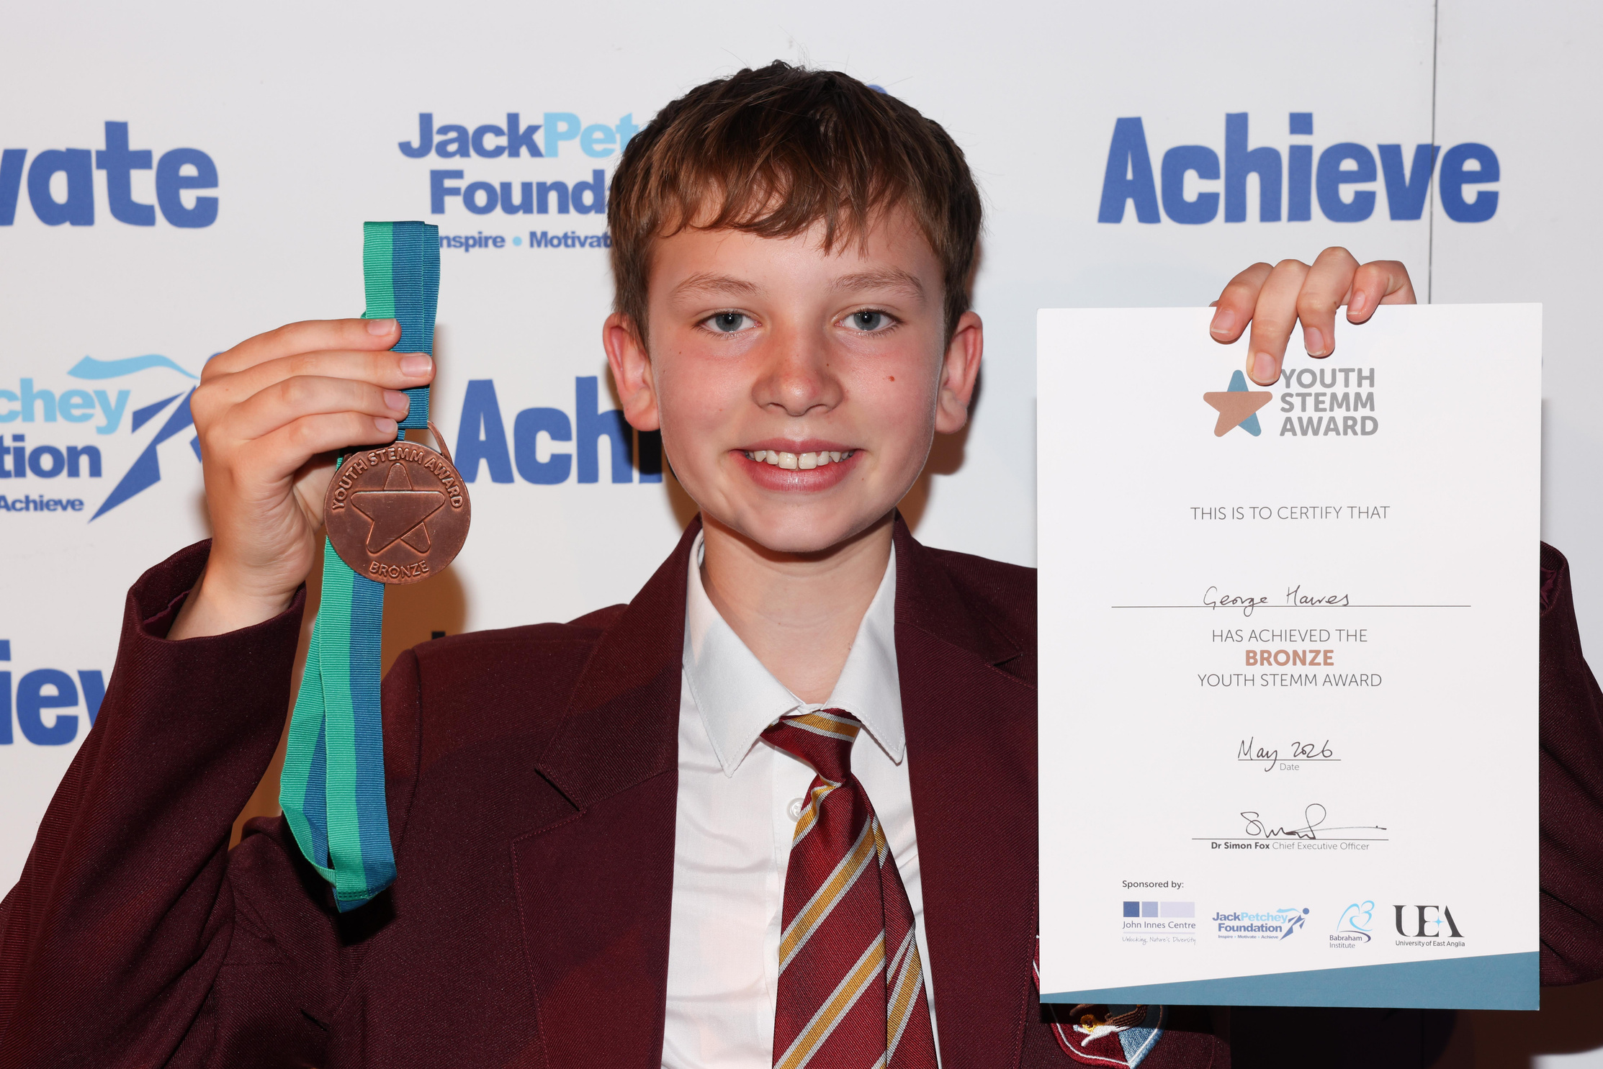
A skills award for 11-19's
to develop and evidence skills in STEMM
and support applications to higher education & jobs

Slide 3

The Babraham Institute is sponsoring 20 places on this programme for our school to support young people into STEMM.

Slide 4





STEMM stands for:
Science
Technology
Engineering
Maths
Medicine

Slide 5





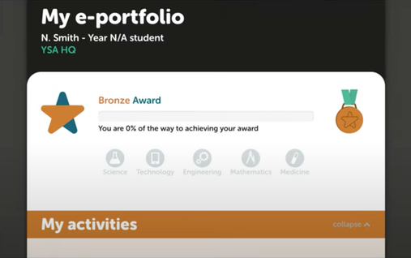
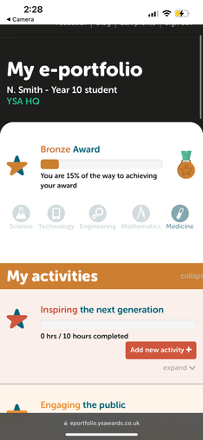


How it works:
1
2
3
Take part in extracurricular
STEMM-based activities and choose which strand to log the time under.
Add details of your activities to the YSA e-portfolio to complete the strands and earn virtual badges. Each submission gets approved by the school coordinator.
Complete enough hours and reach the criteria to achieve your Award at Bronze, Silver, or Gold levels.

Slide 6
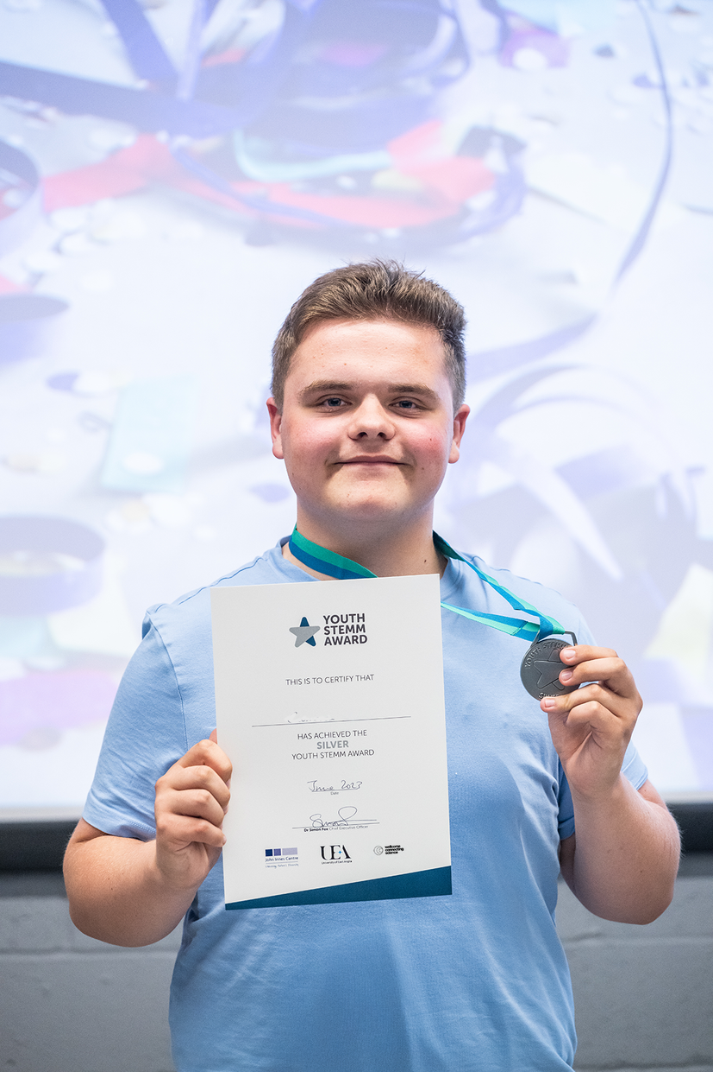
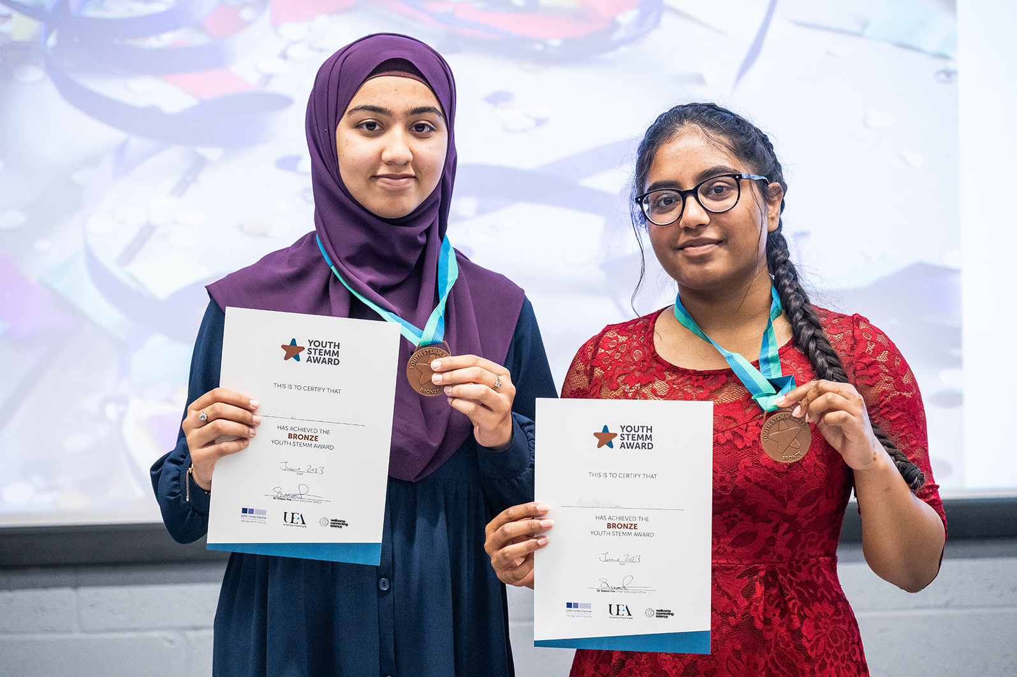

When you complete
This experience has been invaluable and I more than recommend you pursue this award
you'll receive a
medal, certificate and digital badge

Slide 7

What is required for Bronze Level?
Undertake a minimum of 45-hours of STEMM-based activities
Log activities in each of the five STEMM areas (Science, technology etc..)
Complete the four stands, meeting the criteria required for each
Upgrade at any time to silver level (requires more hours)

Slide 8




The four YSA strands:
Developing leadership skills and confidence
Example: Helping younger children do a science experiment
Focusing on communication skills
Example: volunteering at school open evening
Following curiosity beyond the national curriculum
Example: Reading a science magazine
Exploring STEMM careers and training opportunities
Example: Watching a careers talk

Slide 9
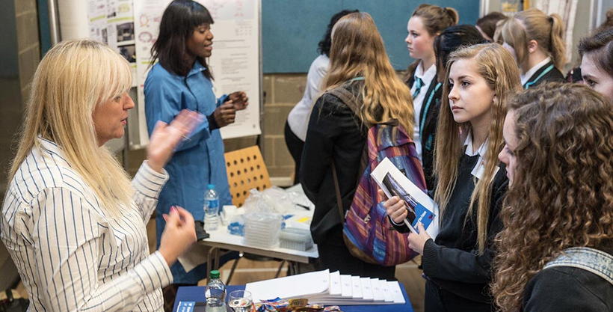
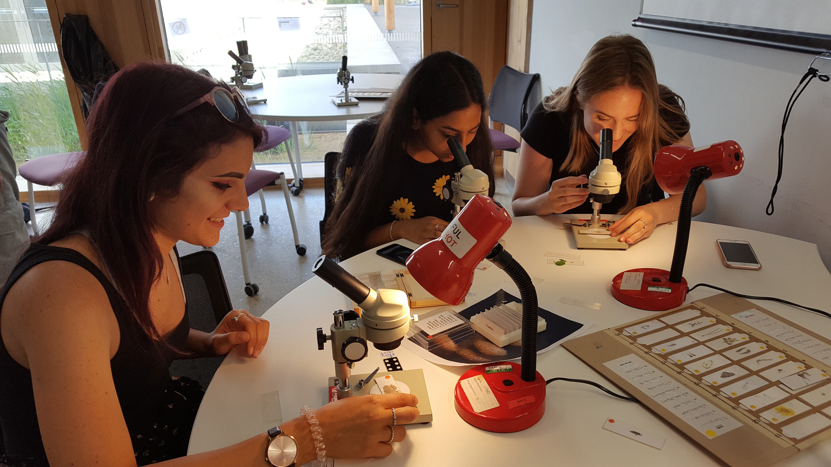

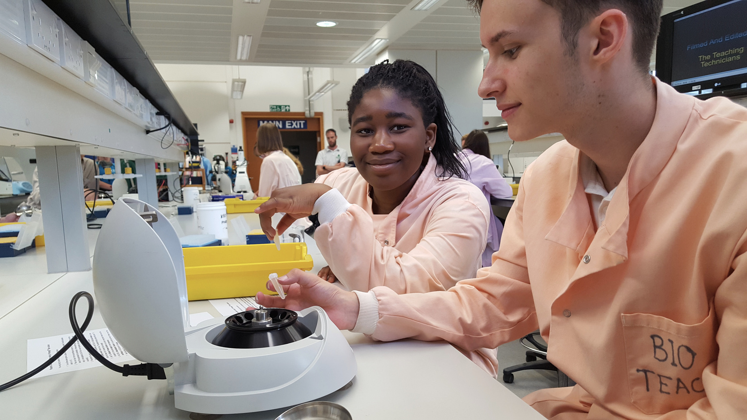
Any activity that involves an element of STEMM could count towards your Award:
Must involve at least one area of STEMM (can be more than one area)
Must be outside of normal lessons or homework
Lots of activities you may already do could count, including online and at home, after school clubs, trips, visits, work experience and careers days!

Slide 10
Can activities count if undertaken at school/college?
Yes (if STEMM related):
Does NOT count:
After school clubs, open evenings, public events etc
Work carried out in normal lessons
Organised trips and visits, or guest speakers coming into school/college
Homework
Exam/syllabus revision of topics learnt in school/college
Extra study in your spare time to learn more about a topic that you may have touched on at school (not set homework)
Activities that don't involve or relate to STEMM topics

Slide 11
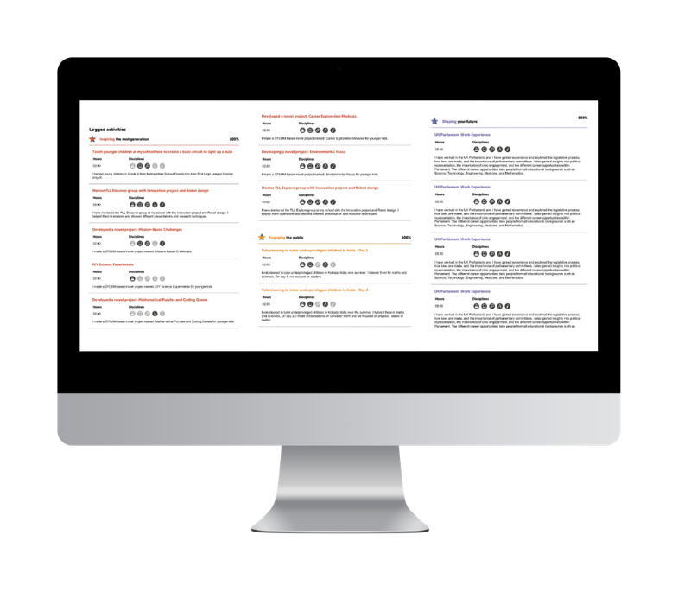
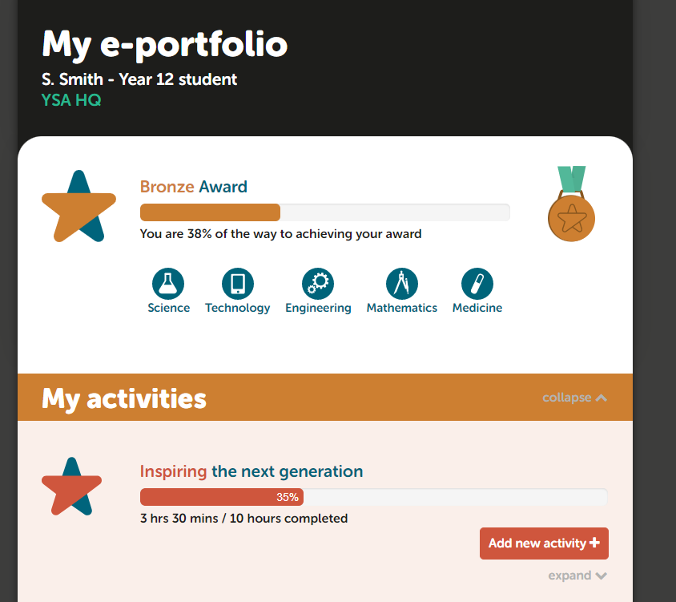
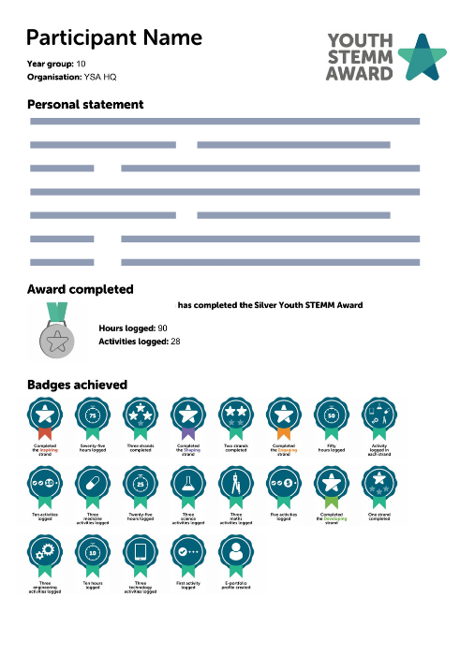
The YSA e-portfolio is easy to use and a great way to track progress:
Its downloadable and provides a handy record of achievement for applications later on. Each YSA journey is unique!

Slide 12
Once you are registered you can start logging activities:
Your e-portfolio is where you will log all the activities you take part in during your Award
Your YSA coordinator will set you up on the system
Look out for the welcome email and follow the link to log in, set your password and complete your profile information
See how far you have
Trouble shooting:
If you do not receive your welcome email, log in via the YSA website and click 'forgot password'.

Slide 13
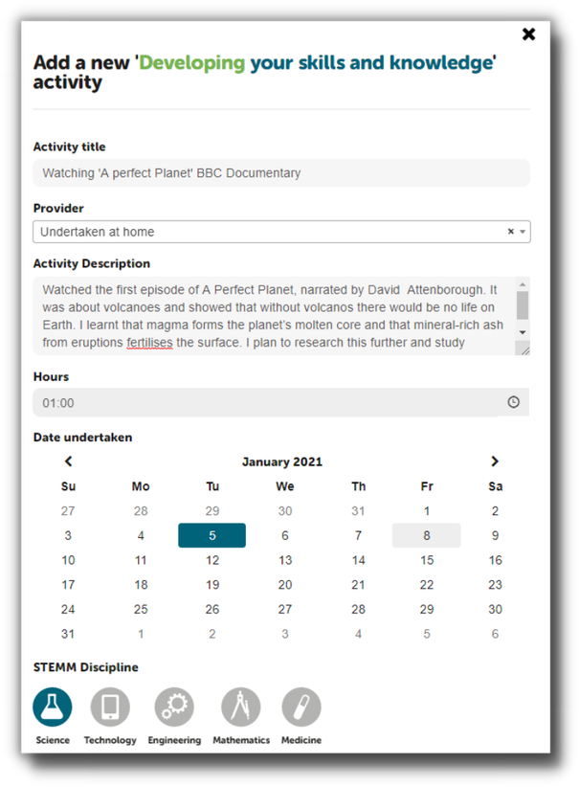

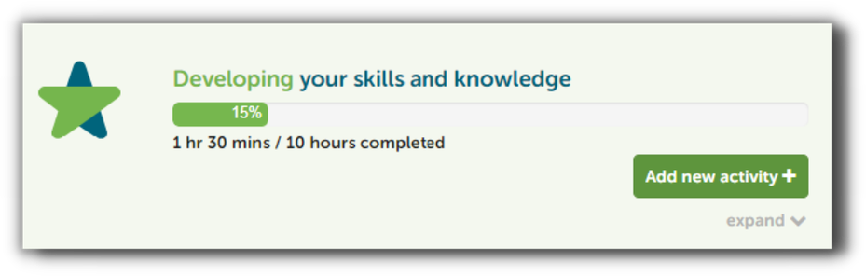
How to submit an activity:
To log an activity, visit www.ysawards.co.uk and follow the link to sign in to the e-portfolio
1
3
Enter the details on the form, making it clear what you did and what you learned from the activity
2
Choose the strand that best matches the activity and click 'add new activity'
See the participants handbook and video for more guidance

Slide 14
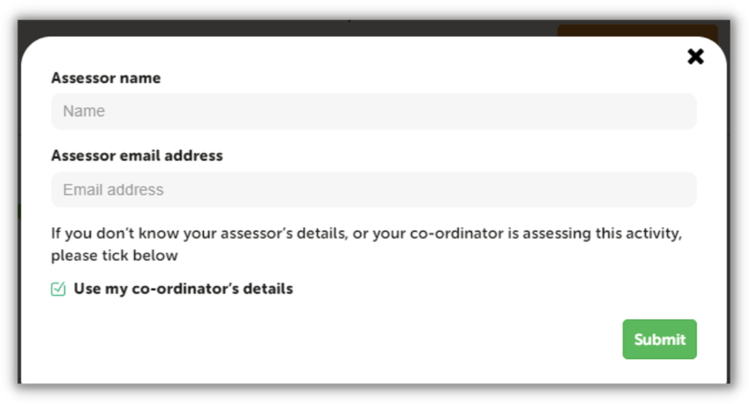
Who checks your submitted activities?
Every activity must be validated by an independent person who can confirm that you took part
Provide the name and email address of an independent adult who was involved with the activity and can confirm you took part, e.g., your work experience host
or:
Your coordinator will moderate your e-portfolio to check your activities and make sure you meet the criteria for the Award
You can tick to use your coordinators details if appropriate, for example if you did the activity at home or it was part of a school-organised trip

Slide 15
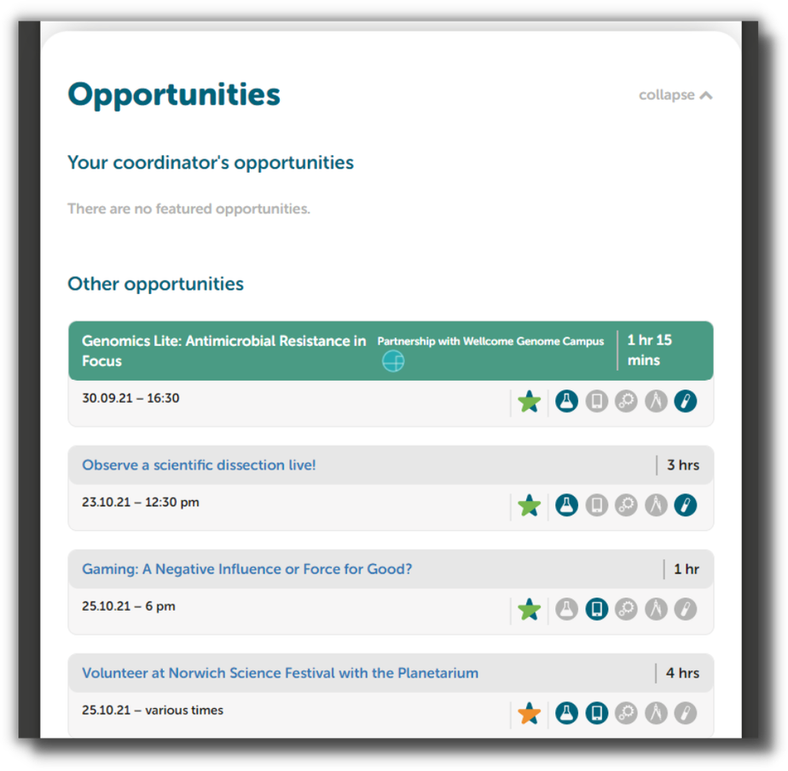
Activity opportunities:
Check out the 'opportunities' section of your e-portfolio
4
Plus check out the YSA newsletter for lots more ideas of what you can do to earn your hours!
Visit www.ysawards.co.uk and use the 'sign up' form at the bottom of the page to subscribe

Slide 16

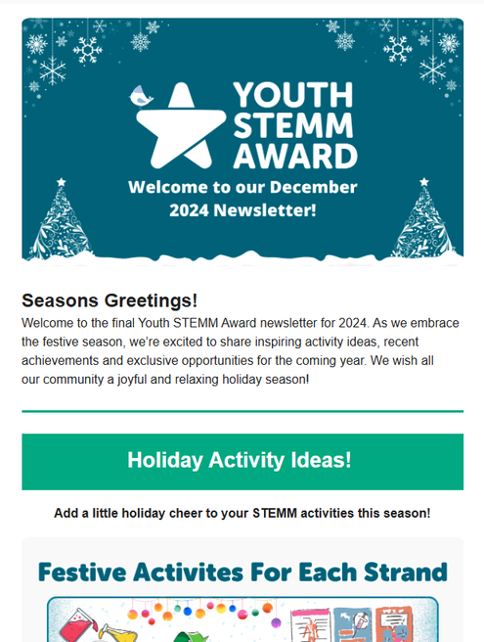

Visit the YSA website for more guidance
subscribe to our newsletter for loads of activity ideas!

Slide 17
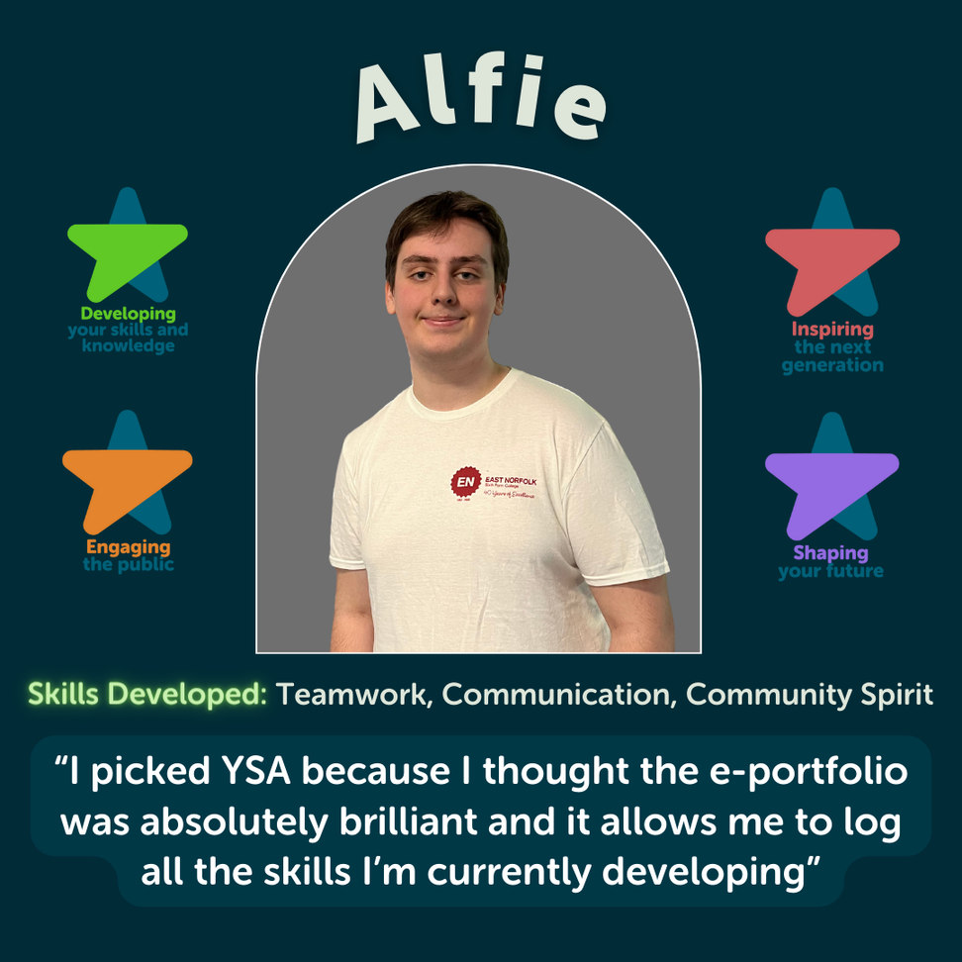
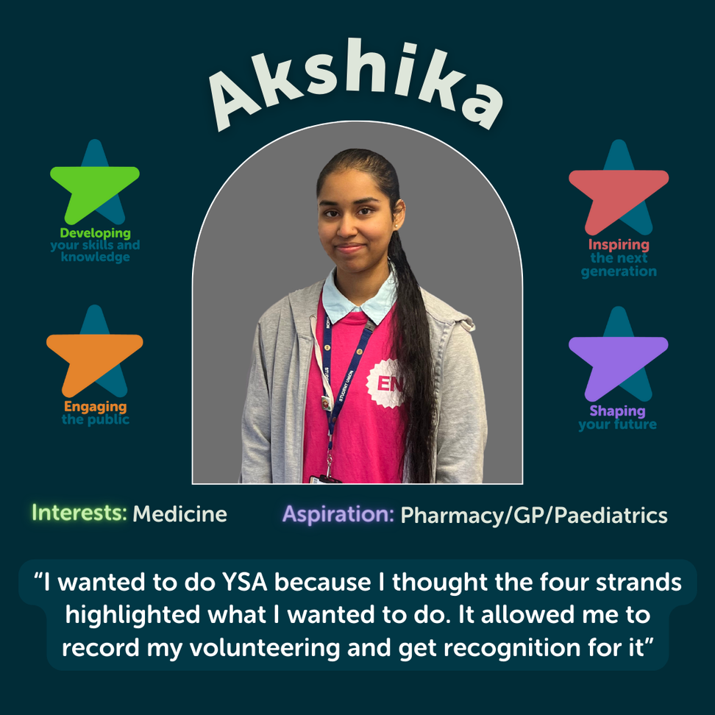
What students say about taking part:

Slide 18
Achievers’ Feedback
Amanueal - Youth STEMM Award Gold Achiever
“It's not just an award - it's a catalyst for personal and professional transformation.”
Taryn- Youth STEMM Award Silver Achiever
“It really helped me to discover the different opportunities presented through STEMM, and ultimately sparked my interest in science.”

Slide 19


Its great to add to your university application form

Slide 20

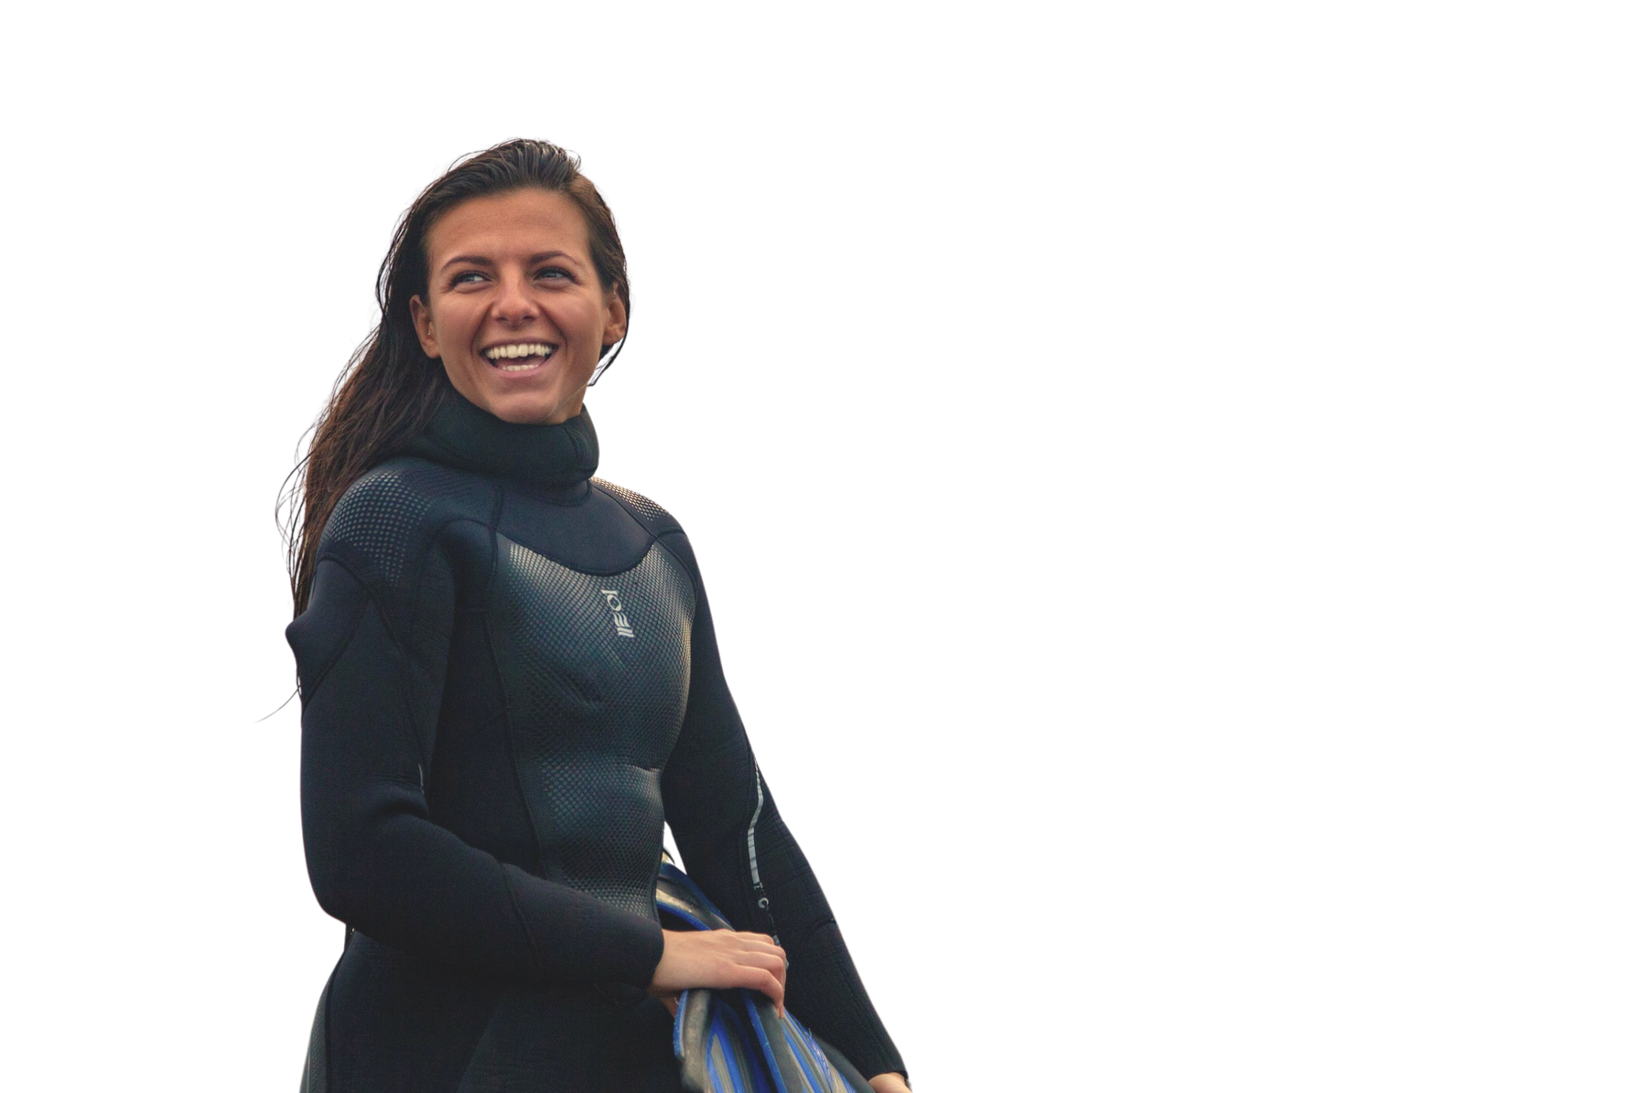
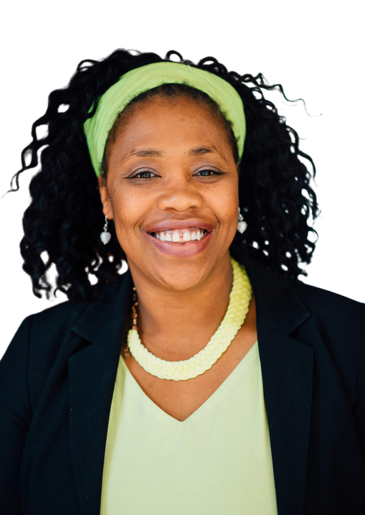
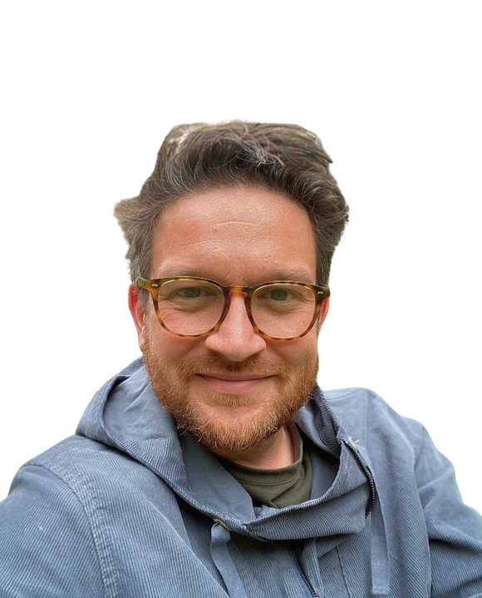
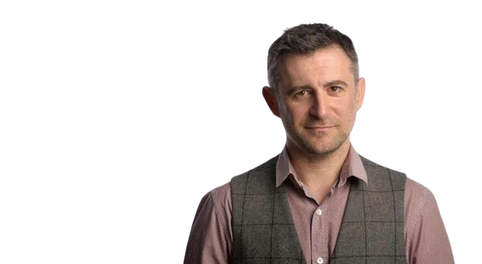

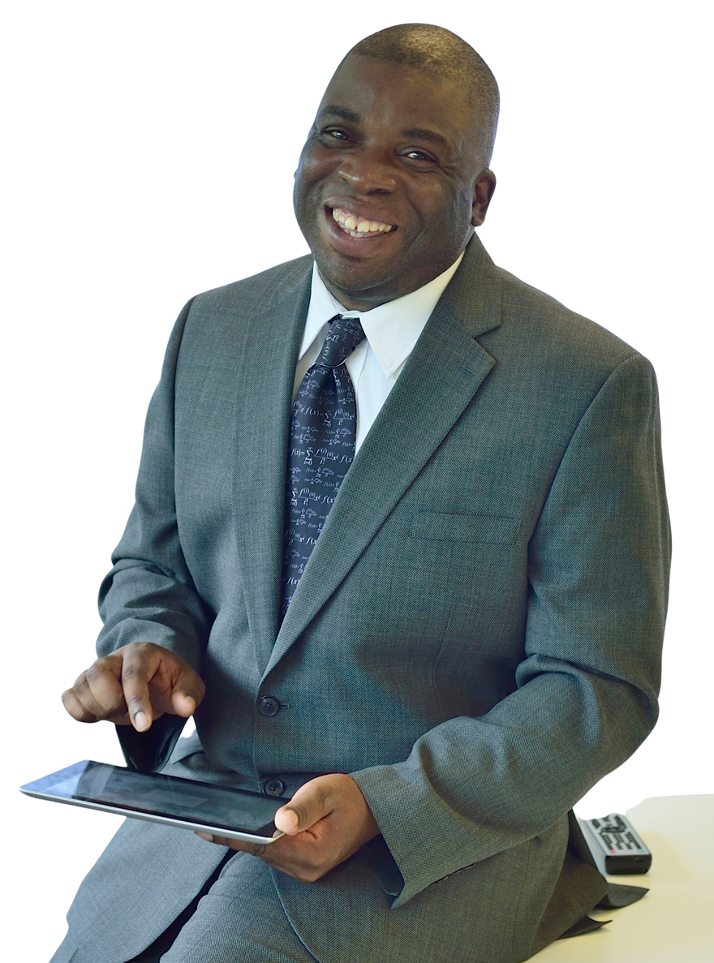
Meet our ambassadors
Professor Ben Garrod
Maddie Moate
Dr Nira Chamberlain
Lizzie Daly
Dr Marcia Philbin
Mark Thompson

Slide 21
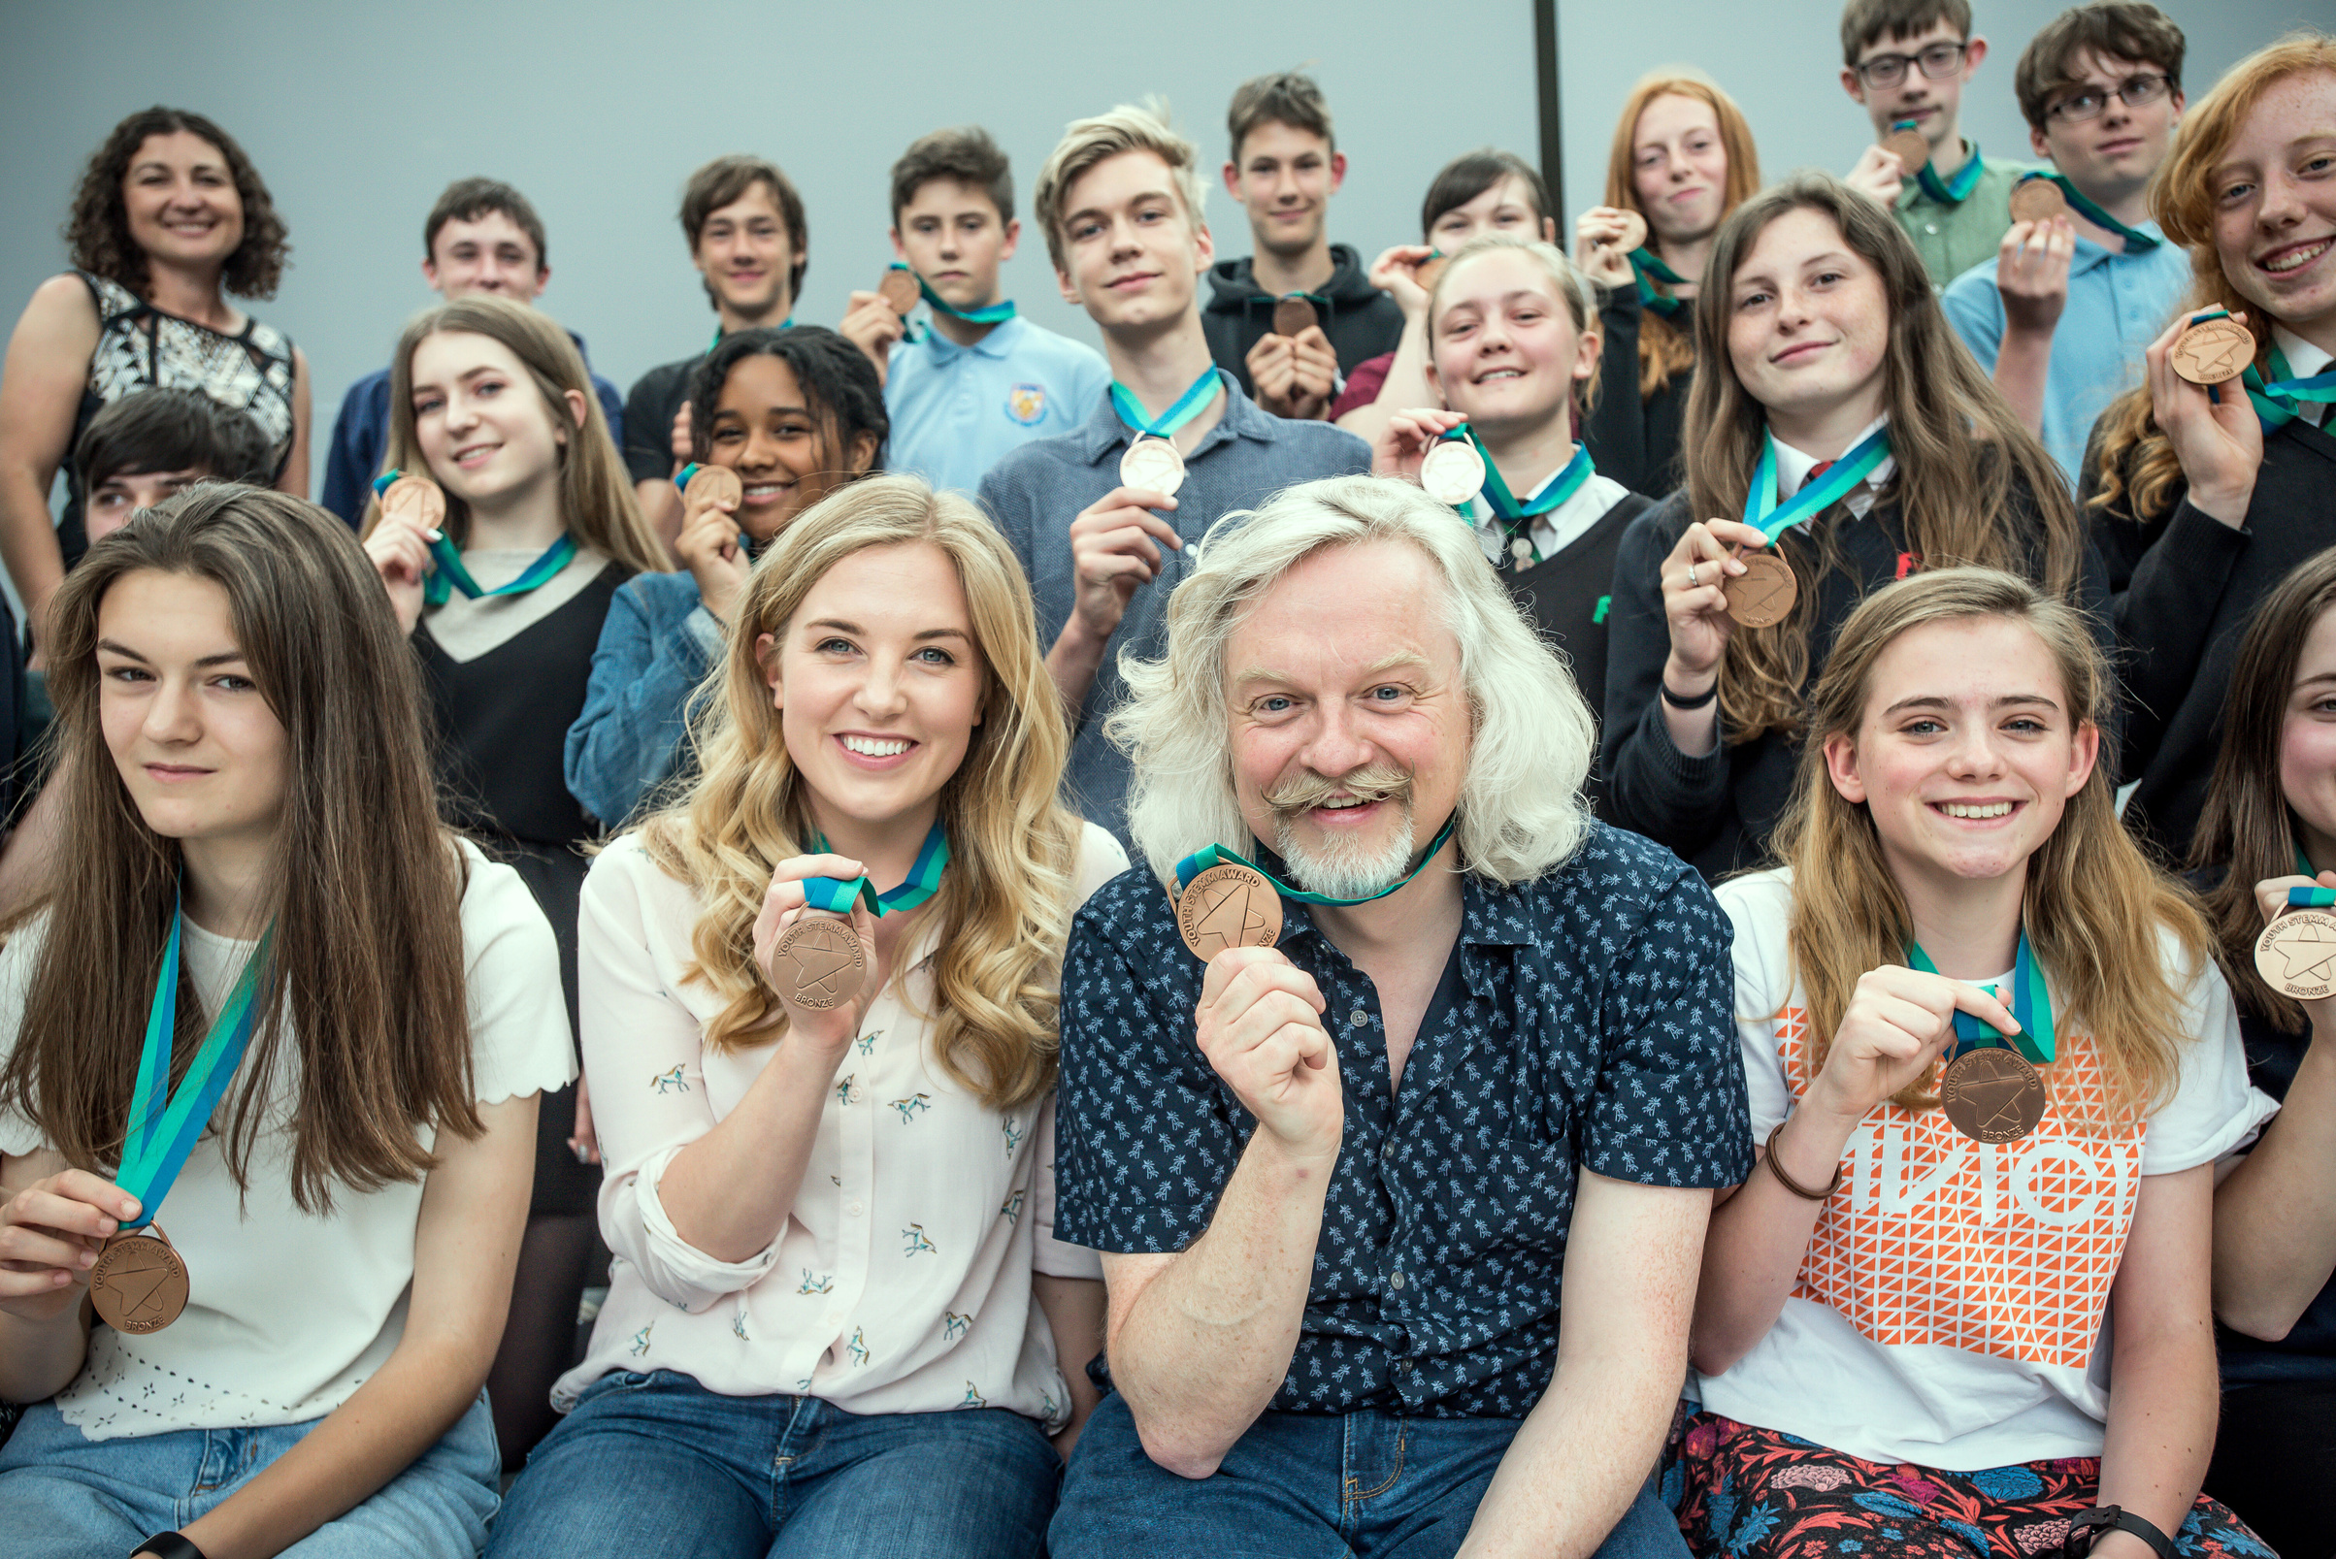
If something like the YSA had been around when I was at school, I honestly think I'd have explored my passion for science sooner, discovering it wouldn't just lead me down the stereotypical path of life in a white lab coat, but something that could be creative, social and full of adventure.
Maddie Moate,
TV presenter, author
and YSA Ambassador
Ambassadors Maddie Moate and Marty Jopson presenting medals

Slide 22











Thanks to our Partners and Collaborators

Slide 23

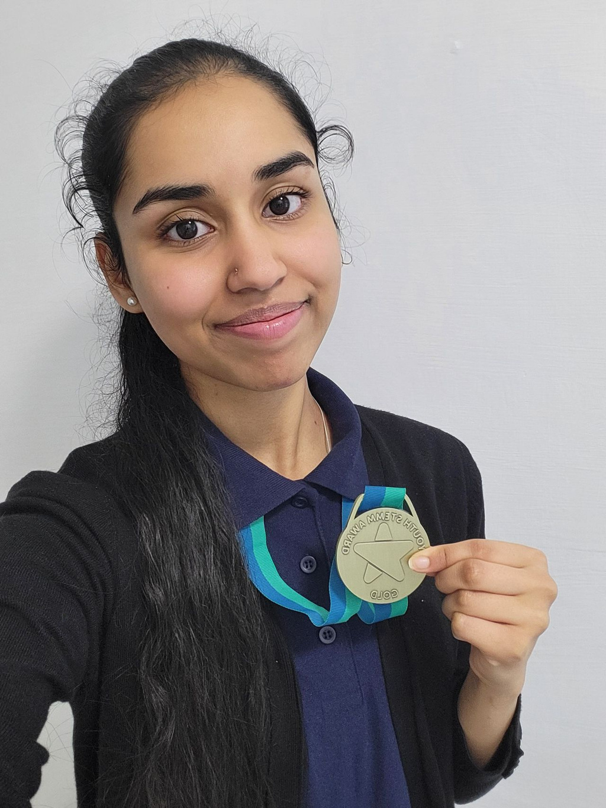
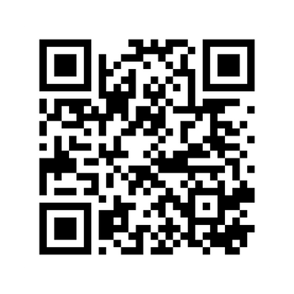
Get involved!
www.ysawards.co.uk

